Slide 1


Solution to an equation
Task A: Testing solutions to equations
Fill in the table for both expressions. Use your table to find the solution to the equation.
a)
b)
c)
equation
2x + 3 = 4x − 5
 | x = 1 | x = 2 | x = 3 | x = 4 | x = 5
2x + 3
4x − 5
solution
equation
3(x − 4) = 5x
 | x = 2 | x = 0 | x = −2 | x = −4 | x = −6
3(x − 4)
5x
solution
equation
20 − 2x = 2x + 10
 | x = 1 | x = | x = 2 | x = | x = 3
20 − 2x
2x + 10
solution
2) Sort these equations into the correct column in the table.
has x = 2 as a solution | has x = 0 as a solution | has no solution
5x = 10
x = 3x
5(x + 1) = 15
2 − x = 7 − x
3(2x + 5) = 6x − 2
3x − 6 = 0
2x + 5 = 2x + 3
2x − 2 = 6 − 2x
x − 2 = 10x − 2

Slide 2
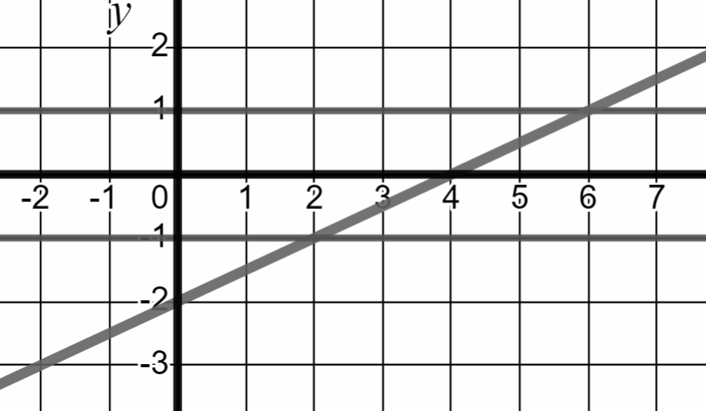
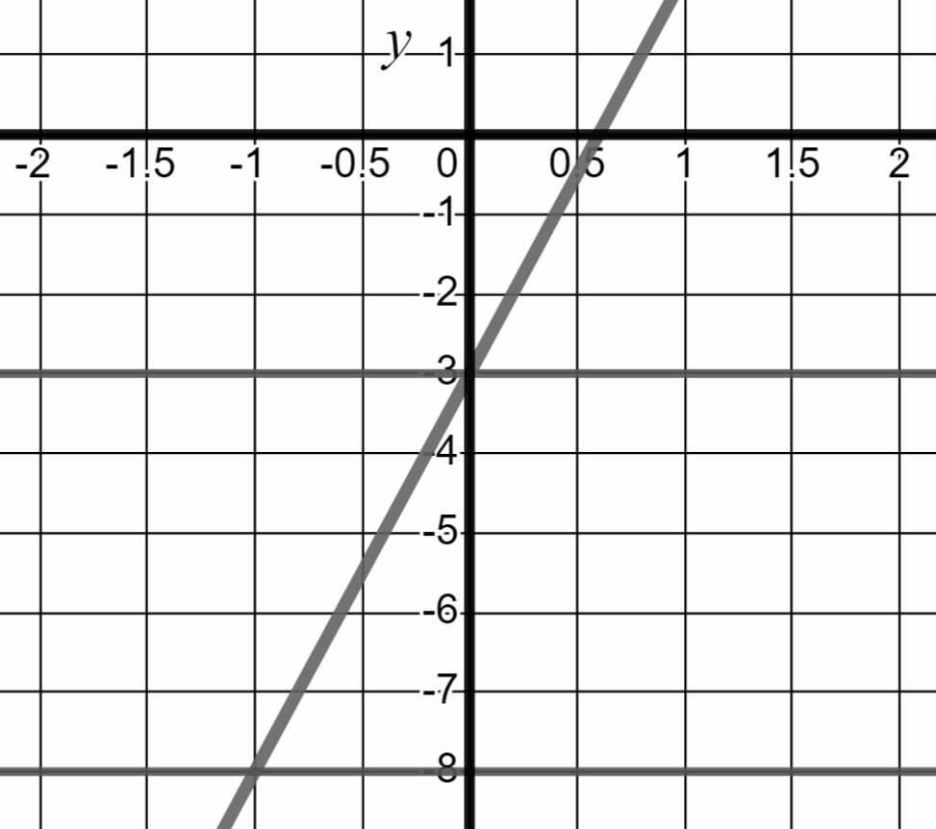
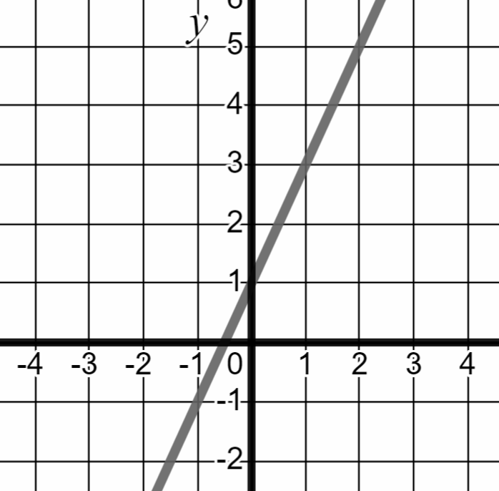

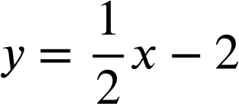


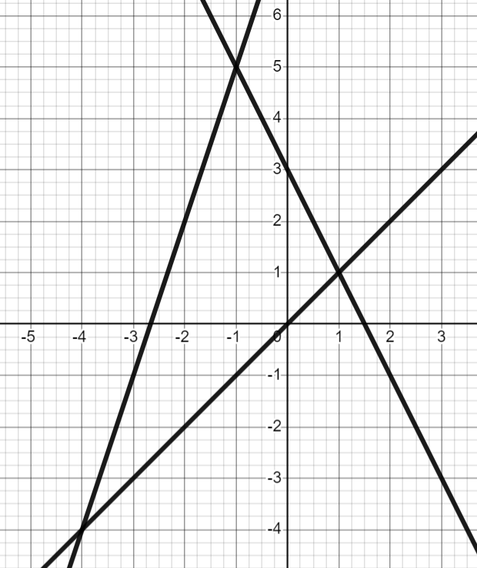
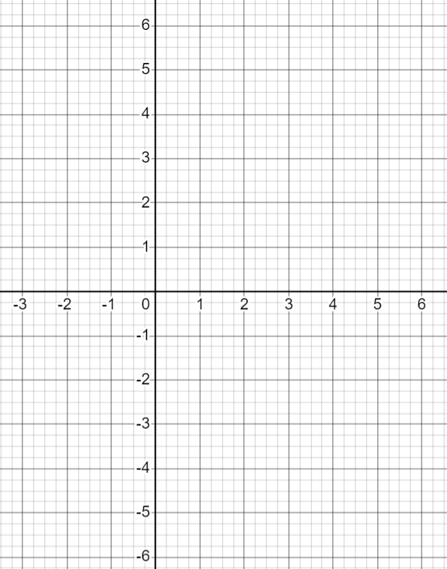



Solution to an equation
Task B: Finding solutions from graphs
1a) Use the lines on the graph to solve the equations below.
1b) Below is the graph of the equation y = 5x − 3 Use it to solve the equations.
1c) Solve the equations below by drawing the relevant graph.
equation | solution
x − 2 = 1
x − 2 = −1
equation | solution
5x − 3 = −3
5x − 3 = −8
equation | solution
2x + 1 = 3
2x + 1 = 1
2) Use the lines on the graph to solve the equations.
3) Solve the equation below by drawing the relevant graphs.
y = 3x − 3
x | −1 | 0 | 1 | 2 | 3
y
y = 5 − x
x | −1 | 0 | 1 | 2 | 3
y
a) | equation | solution
 | x = 3 − 2x
b) | equation | solution
 | x = 3x + 8
equation | solution
3x − 3 = 5 − x
c) | equation | solution
 | 3x + 8 = 3 − 2x
Mathematics in Education and Industry

